Slide 1
Daily Review
CFU 1
True or False: Electrostatic charge is caused by the movement of protons.
Electrostatic Charge
Electric charge is either positive or negative.
Electrons – negative
Protons – positive
Usually objects are uncharged, but when electrons move from one object to another (e.g. by rubbing together) it create:
An area of relatively positive charge (has lost electrons)
An area of relatively negative charge (has gained electrons)
We call this difference in charge – Electrostatic Charge
CFU 2
If an object gains electrons, will it be coming negatively charged, or positively charged?

Slide 2
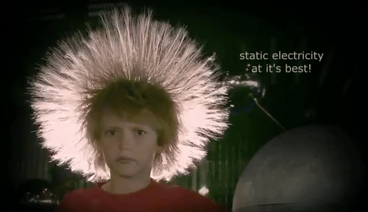
Daily Review
CFU 1
True or False: Electrons are attracted to each other.
Electrostatic Charge
When charged particles are near each other they apply an electrostatic force on each other.
Like charges repel
E.g. 2 positive particles push away from each other
Unlike charges attract
E.g. a positive particle and a negative pull towards each other
CFU 2
Explain why the boys hair is standing on end and spreading out.

Slide 3
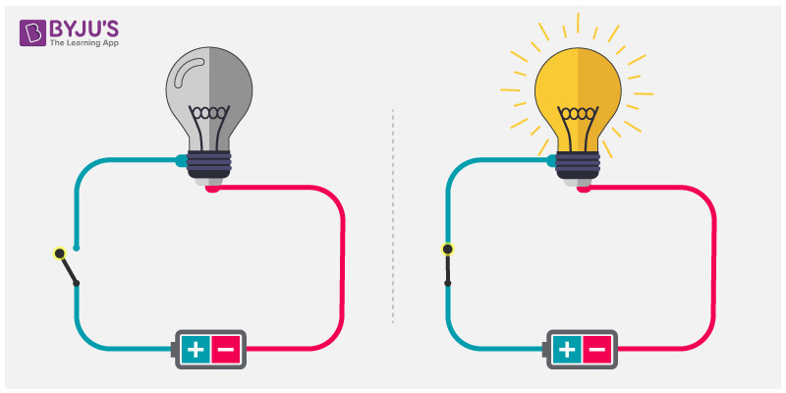
Daily review
CFU 1
List the 3 essential components of all electric circuits
Electric Circuits
A pathway travelled by electrical energy
Circuits can vary from very complex (e.g. in your phone) to very simple (e.g. in a torch)
However all circuits have 3 essential components
A power source
A pathway
A load
We typically also put a switch into our
circuits, to allow us to control when they
are open and closed
CFU 2
Describe a switch, and explain why it is useful in a circuit
Vocabulary

Slide 4
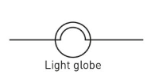
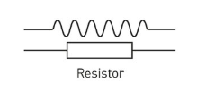
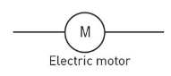
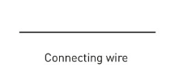
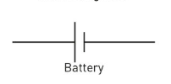
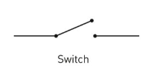
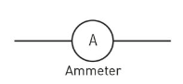
Daily review
Circuit Diagrams
Using your worksheet from the last lesson, identify the following components of electrical circuits.
1
4
2
5
7
6
3

Slide 5
Conductors and Insulators Year 9 Physics

Slide 6
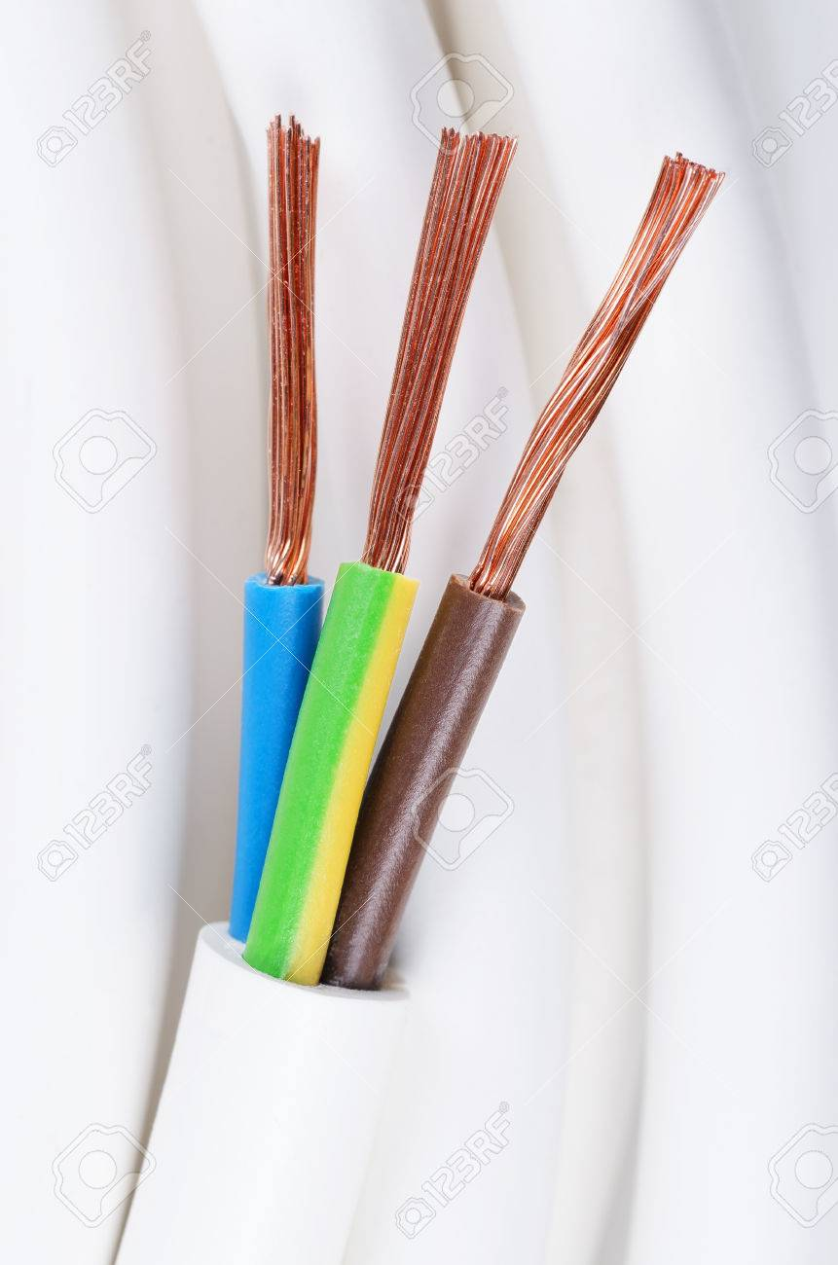
Learning Objectives
CFU
What are we going to learn today?
Describe conductors and insulators
Identify different materials as conductors or insulators
Activate Prior Knowledge
Power cables are made of a copper wire, surrounded by a plastic.
Why do you think they choose these materials?

Slide 7
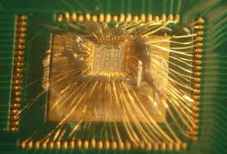
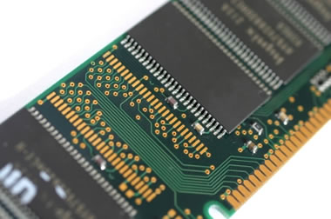
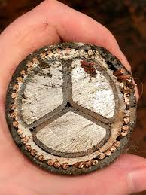
Concept Development
CFU 1
Define the term “conductor”
Conductors
A material that allows the flow of charge.
Some good conductors are:
Copper
Gold
Aluminum
silver
CFU 2
What do these 4 conductors have in common?

Slide 8
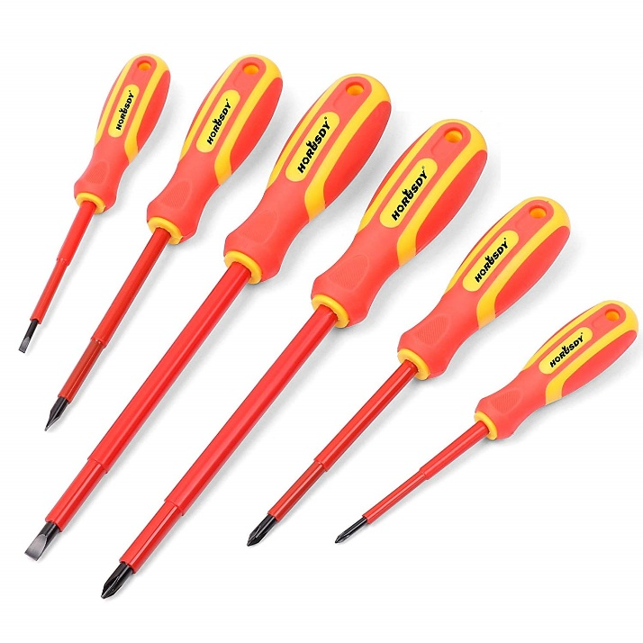
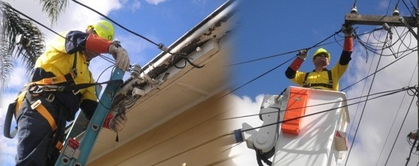
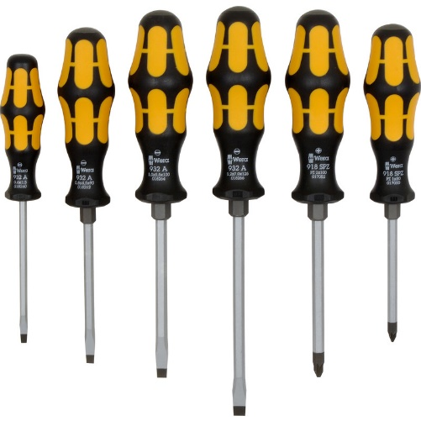
Concept Development
CFU 1
Define the term “insulator”.
Insulators
A material that does not allow the flow of charge.
Some good insulators are:
Glass
Air
Plastic
Rubber
Wood
CFU 2
List 3 good insulators.
CFU 3
Think-pair-share: The red screw drivers are specific electrical screw drivers where as the yellow ones are not. Describe how they are different, and why.

Slide 9
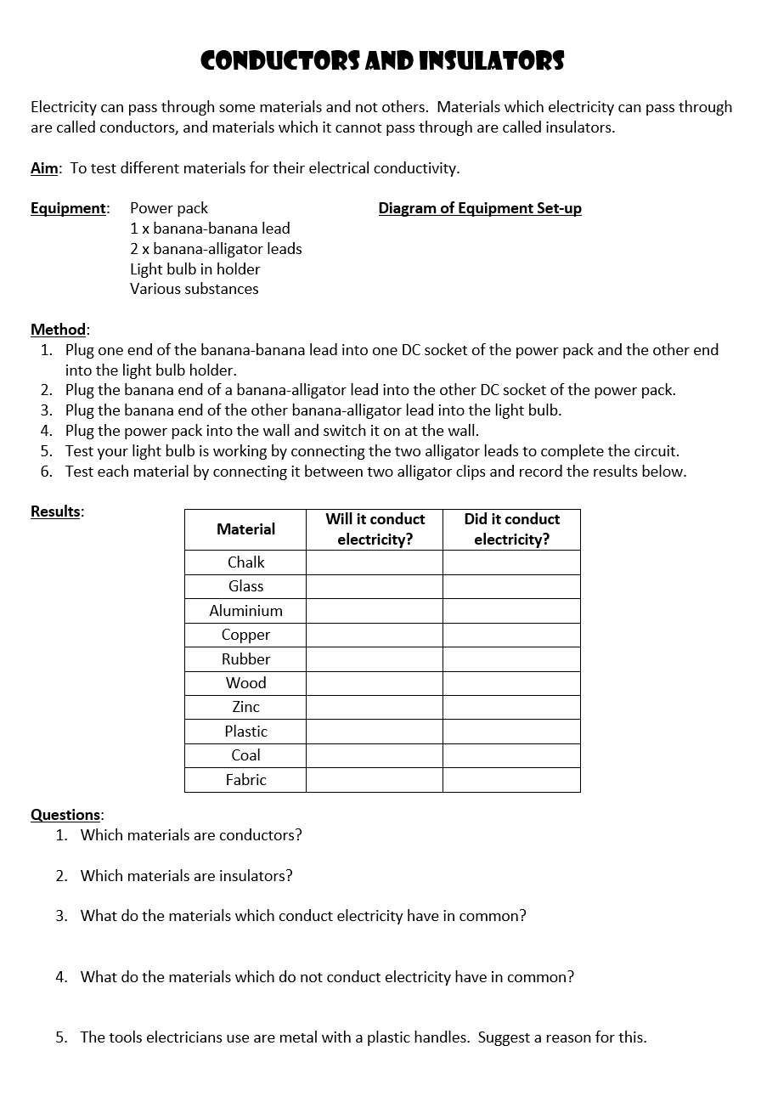
Guided Practice
Follow your teachers instructions to complete the practical on conductors and insulators.
When you finish the experiment, work through the questions at the end to consolidate what you have found.

